Slide 1
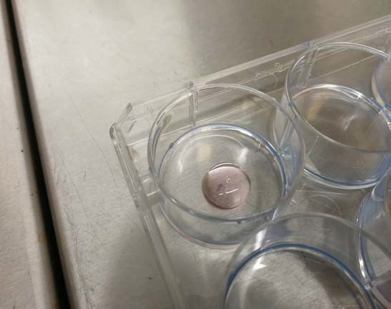
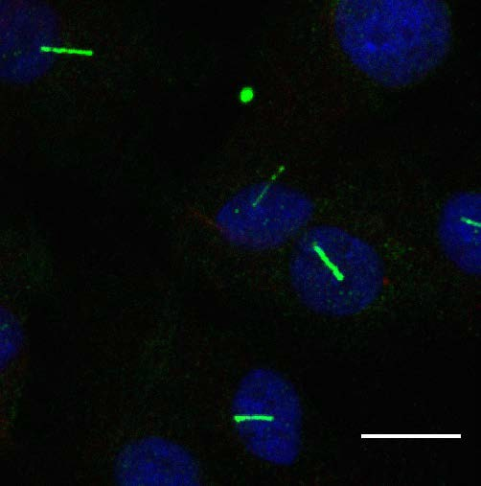
Cilia Assessment in Urine Derived Renal Cell in Autosomal Dominant Polycystic Kidney Disease
Wei Kang Yap*, Dr Shalabh Srivastava, Institute of Genetic Medicine, Newcastle University MBBS (NUMed Malaysia) | 170732279 | W.Yap@newcastle.edu.my
Introduction Results
Autosomal Dominant Polycystic Kidney Disease (ADPKD) is the most common inherited disorder that leads to end stage kidney failure and affects up to 12 million individuals worldwide. ¹
Tolvaptan is the first approved intervention to slow down disease progression, however with many unacceptable side effects, therefore immediate identification of patients at risk of worse prognosis is necessary.
Human kidneys comprise of epithelial cells lined by hair-like structures called cilia.
Defective proteins encoded by the mutated genes are expressed on the cilia of the cells, resulting in atypical cysts growth.
It still remains unknown how the length of cilia is related to the progression of ADPKD in terms of kidney function and volume.
Mean Ciliary Length (micrometer) vs htTKV (mL/m)
7.55
Mean Ciliary Length (micrometer) vs eGFR
7.55
8
7
6
5
4
3
2
1
0
7.27
8
7
6
5
4
3
2
1
0
7.27
Mean Ciliary Length (micrometer)
6.93 6.83
5.64
5.2
Mean Ciiliary Length (micrometer)
6.83 6.93
5.64
5.2
198
221
580 607
htTKV (mL/m)
1073
1122
22
43
66
eGFR
76
87
90
Aim
Figure 3 Relationship between htTKV (mL/m) and mean ciliary length (micrometer) of ADPKD patients. Dots and values in red: patients on tolvaptan. (htTKV = height- adjusted total kidney volume)
Figure 4 Relationship between eGFR and mean ciliary length (micrometer) of ADPKD patients. Dots and values in red: patients on tolvaptan. (eGFR = estimated glomerular filtration rate)
The project aims to study the correlation between the set of genes and clinical data of ADPKD patients with morphology of cilia on kidney epithelial cells derived from their urine samples.
The graphs above showed an average increase of 2.61 cm in mean ciliary length of kidney epithelial cells in the ADPKD patients recruited, compared to a wild type control sample with a mean ciliary length of 3.96 cm.
No significant correlation was found between the mean ciliary length and the kidney volume as well as the kidney function of the ADPKD patients. The use of tolvaptan do not affect the kidney volume and kidney function of patients.
PROPKD score, however, showed that a greater score was associated with an increase in mean ciliary length. The use of tolvaptan led to a reduction in mean ciliary length.
There was no difference in percentage ciliation of kidney epithelial cells between the ADPKD and the wild type control group (not shown).
8
7
6
5
4
3
2
1
Mean Ciliary Length (micrometer) vs PROPKD Score
7.55
Methodology
Mean Ciliary Length (micrometer)
6.83
5.64
A cohort of 6 patients with ADPKD was recruited from within the renal genetics clinic following informed consent.
A fresh urine sample was taken from each patient and a wild-type control sample was obtained from a healthy individual. The samples were processed for hUREC cultures using the protocol.
Around day 10 to 14, cells were plated out in primary cell culture and were passaged where coverslips were seeded (Figure 1).
Cells were serum-starved for 48 hours then fixed and stained with cilia markers, ARL 13B and alpha acetylated tubulin for cilia expression studies.
After 48 hours, cells were then stained with DAPI before imaged using fluorescence microscopy.
Images were analysed using ImageJ software in which the mean cilia length and percentage ciliation were calculated and recorded (Figure 2).
The data were then correlated with the phenotypic data (kidney function and volume) as well as the patients’ genotype.
0
3
5
7
Discussion
PROPKD Score
htTKV, eGFR and PROPKD score were used as the biological parameters to indicate the patients’ kidney volume, kidney function and the risk of progression to end stage renal failure at age 60 respectively. PROPKD score includes the gender, hypertension before age of 35, first urologic event before age of 35 and genetic mutation of the patients. A larger value of htTKV, a lower eGFR value or a greater PROPKD score estimate a poorer prognosis of renal disease progression. PROPKD score is only applicable for patients of age 35 and above, only data of 3 patients in the study can be recorded. ^{2,3}
Due to time constraint, the sample size of the project was relatively small. A larger cohort of patient, both with and without tolvaptan treatment, should be recruited in the future work.
Other factors such as response of the patients to tolvaptan, duration of the treatment and patients’ compliance to medications should be taken into consideration to establish relationship between tolvaptan treatment and reduction in mean ciliary length.
Figure 5 Relationship between PROPKD and mean ciliary length (micrometer) of ADPKD patients. Bar and value in red: patients on tolvaptan. (PROPKD = predicting renal outcomes of ADPKD)
Conclusion
The increase in mean ciliary length in urine-derived renal cells in ADPKD does not associate with the kidney volume and kidney function of the patients. A greater PROPKD score is associated with a greater increase in mean ciliary length.
There is no significant result indicating that the use of tolvaptan leads to a reduction in mean ciliary length.
References
Chapman AB, Devuyst O, Eckardt K-U, Gansevoort RT, Harris T, Horie S, et al. Autosomal-dominant polycystic kidney disease (ADPKD): executive summary from a Kidney Disease: Improving Global Outcomes (KDIGO) Controversies Conference. Kidney Int. 2015;88(1):17-27.
Cornec-Le Gall E, Audrézet M-P, Rousseau A, Hourmant M, Renaudineau E, Charasse C, et al. The PROPKD Score: A New Algorithm to Predict Renal Survival in Autosomal Dominant Polycystic Kidney Disease. Journal of the American Society of Nephrology. 2016;27(3):942.
Chebib FT, Perrone RD, Chapman AB, Dahl NK, Harris PC, Mrug M, et al. A Practical Guide for Treatment of Rapidly Progressive ADPKD with Tolvaptan. Journal of the American Society of Nephrology. 2018;29(10):2458.
Figure 1 Renal tubular epithelial cell seeded on coverslips.
Figure 2 Cilia on cells shown in fluorescence microscopy. Cells were stained blue with DAPI stain, cilia were stained green with ARL 13B.
Acknowledgement
Sincere gratitude to my supervisor, Dr Shalabh Srivastava for his kind advice and guidance throughout the project. Funding for this project was provided by Newcastle University Research Scholarships.

